Slide 1
EECS 2500 Linear Data Structures
Lecture 17
Chapter 10 – Searching and Sorting – Part 2
Fall 2016
Dr. Larry G. Thomas – University of Toledo/LCCC

Slide 2
Last Time (1)
Introduced sorting algorithms
Created a “test rig” to show before/after sorting
Simple sorts (§10.2)
Properties of these sorts: They all…
…divide the list into an unsorted part and a sorted part
…use an unsophisticated brute force approach
…are not very efficient
…are easy to understand and to implement

Slide 3
Last Time (2)
Selection Sort
Search through the unsorted part for the smallest remaining item.
Swap that item with the first item in the unsorted part of the list. The sorted part then grows by one slot, and the unsorted part shrinks by one.
Repeat steps 1 and 2 until there is only one item in the unsorted part of the list
Makes ½(N² – N) comparisons
May make up to N swaps

Slide 4
Last Time (3)
Bubble Sort
Starting at the end of the UNsorted part, compare the last two adjacent items (Items #N and N – 1). If they’re not in order (relative to each other), exchange them.
Repeat with the previous pair (items #N – 1 and N – 2)
Continue comparing (and swapping) pairs until we reach the sorted part of the list
Repeat steps 1 – 3 N times.
Makes ½(N² – N) comparisons
May make up to ½(N² – N) swaps

Slide 5
Last Time (4)
Insertion Sort
Start with the sorted part containing one item, and the unsorted part containing the remainder of the list
Take the item at the top of the unsorted part, and repeatedly swap items above it until it reaches its proper location in the sorted part
Repeat step 2 N-1 times.
Makes between N and ½(N² – N) comparisons
Makes between 0 and ½(N² – N) swaps

Slide 6
Last Time (5)
“Sortedness” – counting inversions
A list will have between 0 and ½(N² – N) inversions, depending on how close to sorted (or reverse sorted) it is
The O(N²) sorts ARE O(N²) because they can address, at best, one inversion per operation
O(N lg N) sorts – remove multiple inversions per operation
Typically, they’re divide and conquer (recursive)
MergeSort - O(N lg N) time, but O(N) additional memory requirement

Slide 7
? Questions So Far ?
Any questions so far regarding sorting?

Slide 8
QuickSort
A divide-and-conquer algorithm
Sir Charles Anthony Richard Hoare (Tony): 1960 (When he was 26!)
Inherently recursive
At each stage the part of the array being sorted is divided into two “piles”, with everything in the left pile less than everything in the right pile
The same approach is used to sort each of the smaller piles (a smaller case).
This process goes on until the small piles do not need to be further divided (the base case).

Slide 9
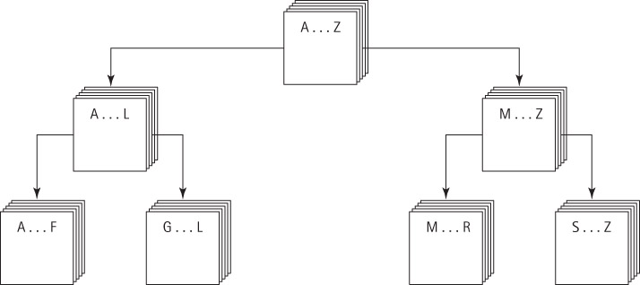
QuickSort Illustrated (Poorly)

Slide 10
QuickSort Summary
Method quickSort (first, last)
Definition: Sorts the elements in sub array between values[first]..values[last].
Size: last – first + 1
Base Case: If size < 2, do nothing
General Case: Split the array according to splitting value
quickSort the elements ≤ splitting value
quickSort the elements > splitting value

Slide 11
The QuickSort Algorithm (2)
The algorithm depends on the selection of a “split value”, called splitVal, that is used to divide the array into two sub arrays.
In some (most) literature the “Split” value is called the “Pivot Value”, and “Splitting” the list is called “partitioning the list around the pivot value”
How do we select splitVal?
One simple solution is to use the value in values[first] as the splitting value.
We could have just as easily arbitrarily selected values[last]
Arbitrarily selecting the pivot value can lead to problems, but we’ll see how to mitigate them later. For now, this is simpler…

Slide 12

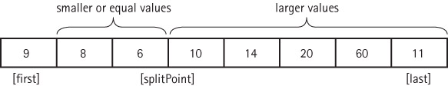
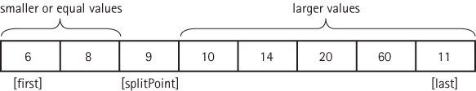
The QuickSort Steps
Once we select the pivot value (arbitrarily chosen here as values[first]), the goal of split is to re-arrange the items between values[first] and values[last] such that everything that winds up to the left of the pivot value is less than the pivot value (but not necessarily sorted), and that everything that winds up to the right of the pivot value is greater than the pivot value (but not necessarily sorted)
Note: The pivot value has found its proper place, and won’t need to be moved again!

Slide 13
The quickSort Method
static void quickSort(int first, int last)
{
if (first < last) // as long as our interval is >= 2 items,...
{
int splitPoint;
splitPoint = split(first, last); // <-- Magic happens here!
// values[first]..values[splitPoint – 1] <= splitVal
// values[splitPoint] = splitVal
// values[splitPoint+1]..values[last] > splitVal
quickSort(first, splitPoint – 1); // sort left side
quickSort(splitPoint + 1, last); // sort right side
}
}

Slide 14
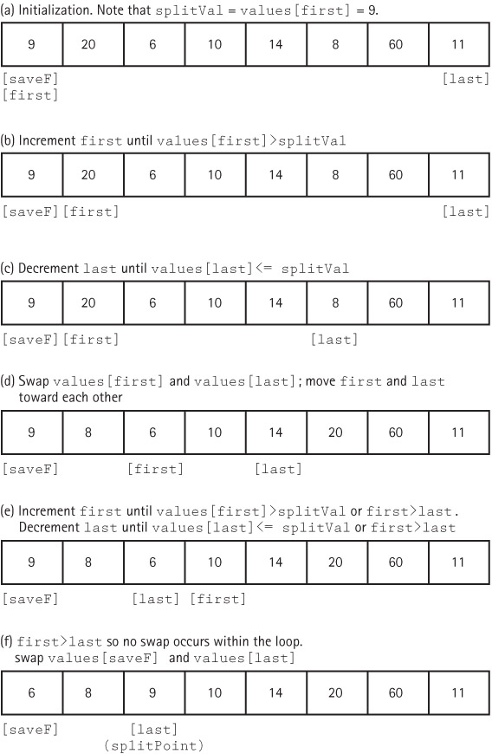
The split Operation
See the code on p. 702
I’m not a huge fan of how Dale, Joyce, and Weems present the split code.
I much prefer what’s on the following slides…

Slide 15
An Example
Quicksort this list:
26 5 37 1 61 11 59 15 48 19
i=lo; j=hi+1; // start at the two ends
X = A[lo]; // Get the pivot value (X) = 26
do {
do i++; while (A[i] < X); // i moves right
do j--; while (A[j] > X); // j moves left
if (i < j) swap A[i] and A[j]; // if i is still left
else break; // of j, swap, and keep going
} while (true);
swap A[lo] and A[j];
return j;
Notes:
15

Slide 16
An Example
Quicksort this list:
26 5 37 1 61 11 59 15 48 19
i j
i=lo; j=hi+1; // start at the two ends
X = A[lo]; // Get the pivot value (X) = 26
do {
do i++; while (A[i] < X); // i moves right
do j--; while (A[j] > X); // j moves left
if (i < j) swap A[i] and A[j]; // if i is still left
else break; // of j, swap, and keep going
} while (true);
swap A[lo] and A[j];
return j;
Notes:
16

Slide 17
An Example
Quicksort this list:
26 5 37 1 61 11 59 15 48 19
i j
i=lo; j=hi+1; // start at the two ends
X = A[lo]; // Get the pivot value (X) = 26
do {
do i++; while (A[i] < X); // i moves right
do j--; while (A[j] > X); // j moves left
if (i < j) swap A[i] and A[j]; // if i is still left
else break; // of j, swap, and keep going
} while (true);
swap A[lo] and A[j];
return j;
Notes:
17

Slide 18
An Example
Quicksort this list:
26 5 37 1 61 11 59 15 48 19
i j
i=lo; j=hi+1; // start at the two ends
X = A[lo]; // Get the pivot value (X) = 26
do {
do i++; while (A[i] < X); // i moves right
do j--; while (A[j] > X); // j moves left
if (i < j) swap A[i] and A[j]; // if i is still left
else break; // of j, swap, and keep going
} while (true);
swap A[lo] and A[j];
return j;
Notes:
18

Slide 19
An Example
Quicksort this list:
26 5 37 1 61 11 59 15 48 19
i j
i=lo; j=hi+1; // start at the two ends
X = A[lo]; // Get the pivot value (X) = 26
do {
do i++; while (A[i] < X); // i moves right
do j--; while (A[j] > X); // j moves left
if (i < j) swap A[i] and A[j]; // if i is still left
else break; // of j, swap, and keep going
} while (true);
swap A[lo] and A[j];
return j;
Notes:
19

Slide 20
An Example
Quicksort this list:
26 5 37 1 61 11 59 15 48 19
i j
i=lo; j=hi+1; // start at the two ends
X = A[lo]; // Get the pivot value (X) = 26
do {
do i++; while (A[i] < X); // i moves right
do j--; while (A[j] > X); // j moves left
if (i < j) swap A[i] and A[j]; // if i is still left
else break; // of j, swap, and keep going
} while (true);
swap A[lo] and A[j];
return j;
Notes:
20

Slide 21
An Example
Quicksort this list:
26 5 19 1 61 11 59 15 48 37
i j
i=lo; j=hi+1; // start at the two ends
X = A[lo]; // Get the pivot value (X) = 26
do {
do i++; while (A[i] < X); // i moves right
do j--; while (A[j] > X); // j moves left
if (i < j) swap A[i] and A[j]; // if i is still left
else break; // of j, swap, and keep going
} while (true);
swap A[lo] and A[j];
return j;
Notes:
21

Slide 22
An Example
Quicksort this list:
26 5 19 1 61 11 59 15 48 37
i j
i=lo; j=hi+1; // start at the two ends
X = A[lo]; // Get the pivot value (X) = 26
do {
do i++; while (A[i] < X); // i moves right
do j--; while (A[j] > X); // j moves left
if (i < j) swap A[i] and A[j]; // if i is still left
else break; // of j, swap, and keep going
} while (true);
swap A[lo] and A[j];
return j;
Notes:
22

Slide 23
An Example
Quicksort this list:
26 5 19 1 61 11 59 15 48 37
i j
i=lo; j=hi+1; // start at the two ends
X = A[lo]; // Get the pivot value (X) = 26
do {
do i++; while (A[i] < X); // i moves right
do j--; while (A[j] > X); // j moves left
if (i < j) swap A[i] and A[j]; // if i is still left
else break; // of j, swap, and keep going
} while (true);
swap A[lo] and A[j];
return j;
Notes:
23

Slide 24
An Example
Quicksort this list:
26 5 19 1 61 11 59 15 48 37
i j
i=lo; j=hi+1; // start at the two ends
X = A[lo]; // Get the pivot value (X) = 26
do {
do i++; while (A[i] < X); // i moves right
do j--; while (A[j] > X); // j moves left
if (i < j) swap A[i] and A[j]; // if i is still left
else break; // of j, swap, and keep going
} while (true);
swap A[lo] and A[j];
return j;
Notes:
24

Slide 25
An Example
Quicksort this list:
26 5 19 1 61 11 59 15 48 37
i j
i=lo; j=hi+1; // start at the two ends
X = A[lo]; // Get the pivot value (X) = 26
do {
do i++; while (A[i] < X); // i moves right
do j--; while (A[j] > X); // j moves left
if (i < j) swap A[i] and A[j]; // if i is still left
else break; // of j, swap, and keep going
} while (true);
swap A[lo] and A[j];
return j;
Notes:
25

Slide 26
An Example
Quicksort this list:
26 5 19 1 61 11 59 15 48 37
i j
i=lo; j=hi+1; // start at the two ends
X = A[lo]; // Get the pivot value (X) = 26
do {
do i++; while (A[i] < X); // i moves right
do j--; while (A[j] > X); // j moves left
if (i < j) swap A[i] and A[j]; // if i is still left
else break; // of j, swap, and keep going
} while (true);
swap A[lo] and A[j];
return j;
Notes:
26

Slide 27
An Example
Quicksort this list:
26 5 19 1 15 11 59 61 48 37
i j
i=lo; j=hi+1; // start at the two ends
X = A[lo]; // Get the pivot value (X) = 26
do {
do i++; while (A[i] < X); // i moves right
do j--; while (A[j] > X); // j moves left
if (i < j) swap A[i] and A[j]; // if i is still left
else break; // of j, swap, and keep going
} while (true);
swap A[lo] and A[j];
return j;
Notes:
27

Slide 28
An Example
Quicksort this list:
26 5 19 1 15 11 59 61 48 37
i j
i=lo; j=hi+1; // start at the two ends
X = A[lo]; // Get the pivot value (X) = 26
do {
do i++; while (A[i] < X); // i moves right
do j--; while (A[j] > X); // j moves left
if (i < j) swap A[i] and A[j]; // if i is still left
else break; // of j, swap, and keep going
} while (true);
swap A[lo] and A[j];
return j;
Notes:
28

Slide 29
An Example
Quicksort this list:
26 5 19 1 15 11 59 61 48 37
j i
i=lo; j=hi+1; // start at the two ends
X = A[lo]; // Get the pivot value (X) = 26
do {
do i++; while (A[i] < X); // i moves right
do j--; while (A[j] > X); // j moves left
if (i < j) swap A[i] and A[j]; // if i is still left
else break; // of j, swap, and keep going
} while (true);
swap A[lo] and A[j];
return j;
Notes:
29

Slide 30
An Example
Quicksort this list:
26 5 19 1 15 11 59 61 48 37
j i
i=lo; j=hi+1; // start at the two ends
X = A[lo]; // Get the pivot value (X) = 26
do {
do i++; while (A[i] < X); // i moves right
do j--; while (A[j] > X); // j moves left
if (i < j) swap A[i] and A[j]; // if i is still left
else break; // of j, swap, and keep going
} while (true);
swap A[lo] and A[j];
return j;
Notes:
30

Slide 31
An Example
Quicksort this list:
26 5 19 1 15 11 59 61 48 37
j i
i=lo; j=hi+1; // start at the two ends
X = A[lo]; // Get the pivot value (X) = 26
do {
do i++; while (A[i] < X); // i moves right
do j--; while (A[j] > X); // j moves left
if (i < j) swap A[i] and A[j]; // if i is still left
else break; // of j, swap, and keep going
} while (true);
swap A[lo] and A[j];
return j;
Notes:
31

Slide 32
An Example
Quicksort this list:
11 5 19 1 15 26 59 61 48 37
j i
i=lo; j=hi+1; // start at the two ends
X = A[lo]; // Get the pivot value (X) = 26
do {
do i++; while (A[i] < X); // i moves right
do j--; while (A[j] > X); // j moves left
if (i < j) swap A[i] and A[j]; // if i is still left
else break; // of j, swap, and keep going
} while (true);
swap A[lo] and A[j];
return j;
Notes:
32

Slide 33
An Example
Quicksort this list:
11 5 19 1 15 26 59 61 48 37
j i
i=lo; j=hi+1; // start at the two ends
X = A[lo]; // Get the pivot value (X) = 26
do {
do i++; while (A[i] < X); // i moves right
do j--; while (A[j] > X); // j moves left
if (i < j) swap A[i] and A[j]; // if i is still left
else break; // of j, swap, and keep going
} while (true);
swap A[lo] and A[j];
return j;
Notes:
33

Slide 34
An Example
Quicksort this list:
11 5 19 1 15 26 59 61 48 37
lo j-1 j i hi
Now our list is partitioned into three segments:
A left part, running from [lo] to [j-1], (may be multiple items)
The pivot value at [j] (just one item), and
A right part, running from [j+1] to [hi] (may be multiple items)
i happens to hold j+1 at this point
Notes:
34

Slide 35
Analyzing quickSort
On the first call, every element in the array is compared to the dividing / pivot value (the “split value”), so the work done is O(N).
The array is divided into two sub-arrays (not necessarily halves)
Each of these pieces is then divided in two, and so on.
If each piece is split approximately in half, there are O(log₂N) levels of splits. At each level, we make O(N) comparisons.
So, quickSort is an O(N log₂N) algorithm.

Slide 36
Drawbacks of quickSort
quickSort isn’t always quicker.
There are log₂N levels of splits if each split divides the segment of the array approximately in half. As we’ve seen, the array division of Quick Sort is sensitive to the order of the data; that is, to the choice of the splitting value.
If the splits are very lopsided, and the subsequent recursive calls to quickSort also result in lopsided splits, we can end up with a sort that is O(N²).

Slide 37
Drawbacks of quickSort
What about space requirements?
There can be many levels of recursion “saved” on the system stack at any time.
On average, the algorithm requires O(log₂N) extra space to hold this information and in the worst case requires O(N) extra space, the same as MergeSort.
In the case of MergeSort, the extra space goes into an auxiliary array; in quickSort, it’s stack space for the recursive calls.

Slide 38
The Final Word on quickSort
Despite the drawbacks, remember that quickSort is VERY fast for large collections of random data
The drawbacks only apply in specific worst-case scenarios
In EECS 2510, we will revisit quickSort and see how to avoid (or a least mitigate) most of the potential problems

Slide 39
heapSort (pp. 704 – 709)
heapSort is based on a data structure known as a heap
Heaps are non-linear data structures (based on binary trees), and as such, will be covered in EECS 2510
You will not be responsible for any of Chapters 8 or 9, or the parts of Chapter 10 that rely on Chapters 8 or 9 (like heaps), unless we have enough extra time leftover, and can back up and cover some Chapter 8 material.

Slide 40
? Questions ?
? Questions ?

